Slide 1


BOOK STORE DATABASE MANAGEMENT SYSTEM Prepared By – Seitmukhanova Dilnaz,Makimova Dilnaz & Nurlanov Eduard

Slide 2
Table of contents
Introduction
ERR Diagram
Normalization
Procedure,Function,Exception and Triggers
Conclusion
In a nutshell, this shows what we are going to cover today in our presentation of “Book store Database Management System”.
We would be more than happy to answer your questions at the end of the presentation!

Slide 3


The main objective of this project is to create a database management system for a book store.
The availability of books and reading material for purchase within the University is quite inadequate. Although the university library has vast collection of books (both hardcopy and e-books), the availability of it is quite limited and bound by many restrictions. Student and staffs only have the option of a small bookshop within the enterprise. Larger books store in the city are often sought for other varieties.

Slide 4

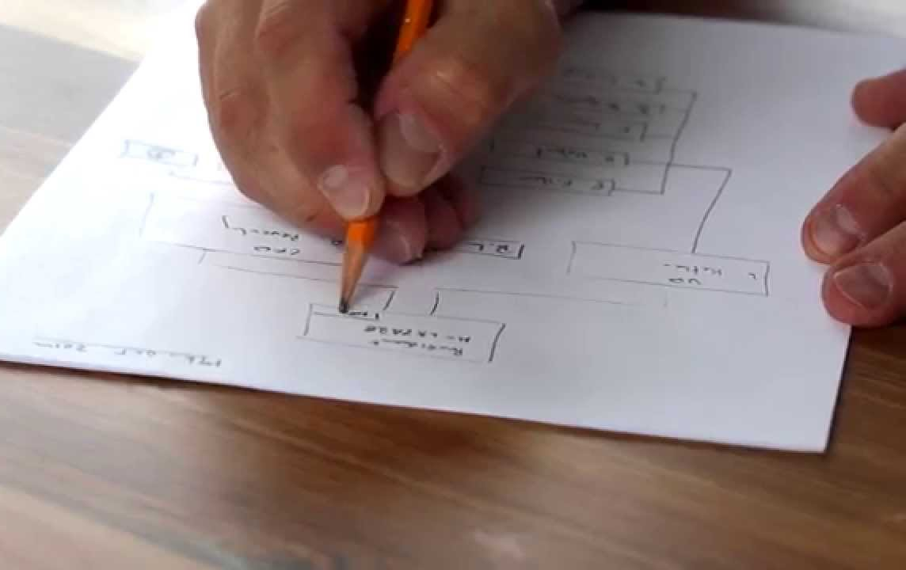
Step:1
ERR-Diagram
We drew the ERR diagram on a paper, noting down all the tables required

Slide 5
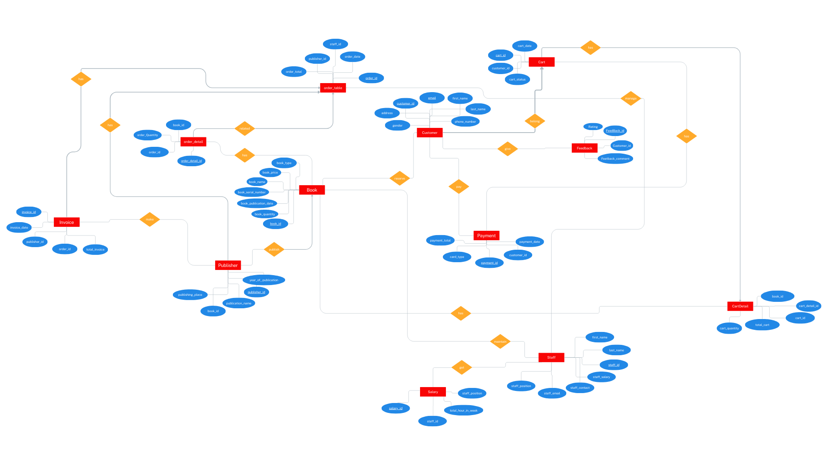

Slide 6

Let us begin exploring the TABLES

Slide 7
Normalization Process We achieved the first normal form by keeping the data scalar. Coming to the second normal form, we tried to make the relationships depend on the primary key. On the third normal for, we made sure that all the dependencies are only on the primary key of the tables.
Third Normal Form
Second Normal Form
First Normal Form

Slide 8
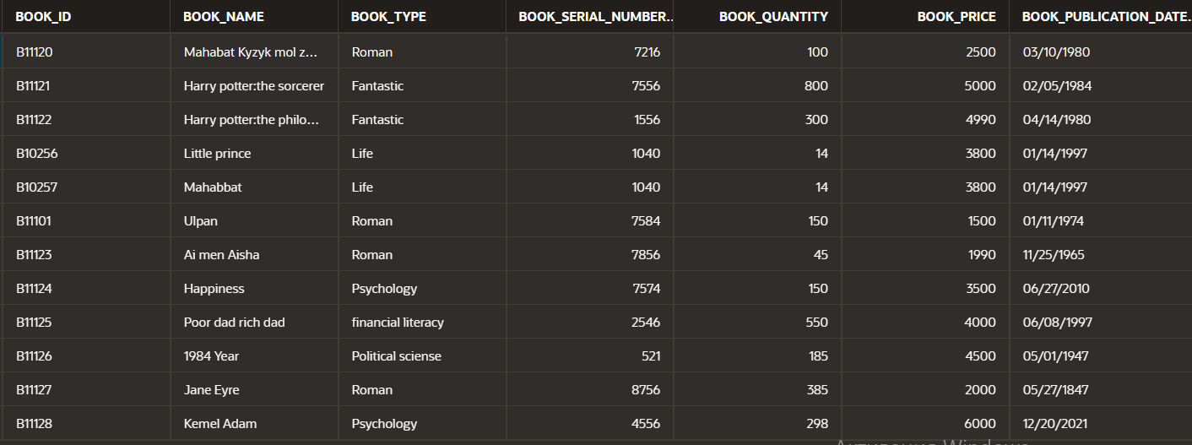
1)Book table
All atrributes have atomatic and have Primary Key. So this table in 1NF
If my table in 1NF and all my non prime attributes depend on Primary key , so this table in 2NF
To be in 3NF, this table shouldn’t be in transitivity dependence. The attributes in our table in non-transitivity dependence.And also it is in 1NF,2NF. So my table also in 3NF.

Slide 9
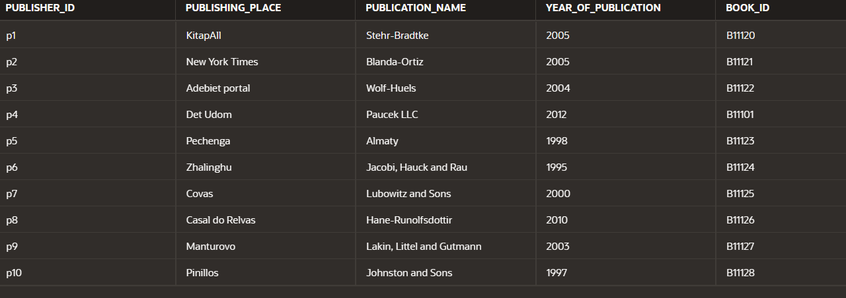
2)Publisher table
All atrributes have atomatic and have Primary Key. So this table in 1NF
If my table in 1NF and all my non prime attributes depend on Primary key , so this table in 2NF
To be in 3NF, this table shouldn’t be in transitivity dependence. The attributes in our table in non-transitivity dependence.And also it is in 1NF,2NF. So my table also in 3NF.
'

Slide 10
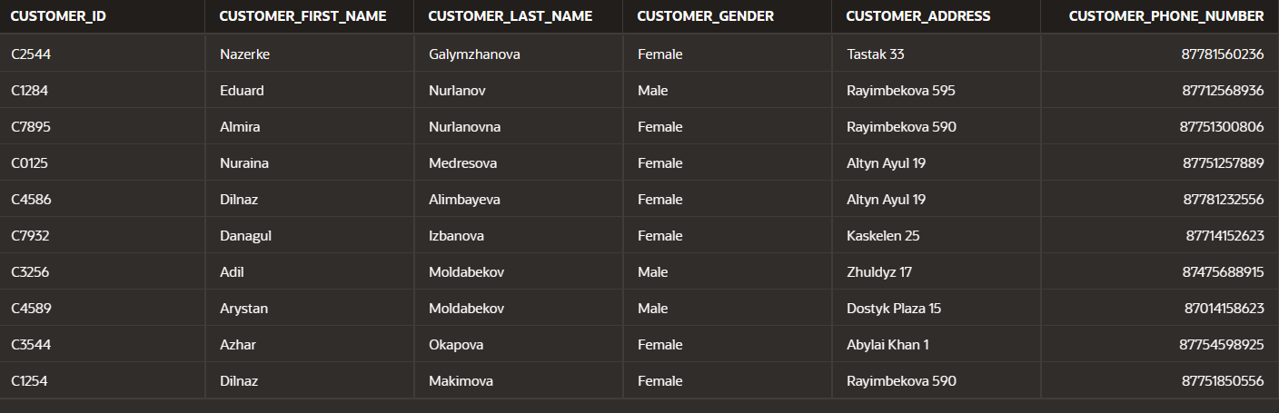
3)Customer table
All atrributes have atomatic and have Primary Key. So this table in 1NF
If my table in 1NF and all my non prime attributes depend on Primary key , so this table in 2NF
To be in 3NF, this table shouldn’t be in transitivity dependence. The attributes in our table in non-transitivity dependence.And also it is in 1NF,2NF. So my table also in 3NF.
'

Slide 11
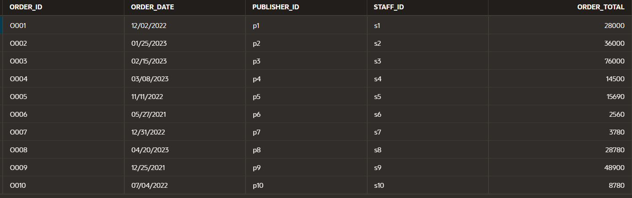
4)Order tabel table
All atrributes have atomatic and have Primary Key. So this table in 1NF
If my table in 1NF and all my non prome attributes depend on Primary key , so this table in 2NF
To be in 3NF, this table shouldn’t be in transitivity dependence. The attributes in our table in non-transitivity dependence.And also it is in 1NF,2NF. So my table also in 3NF.
'

Slide 12
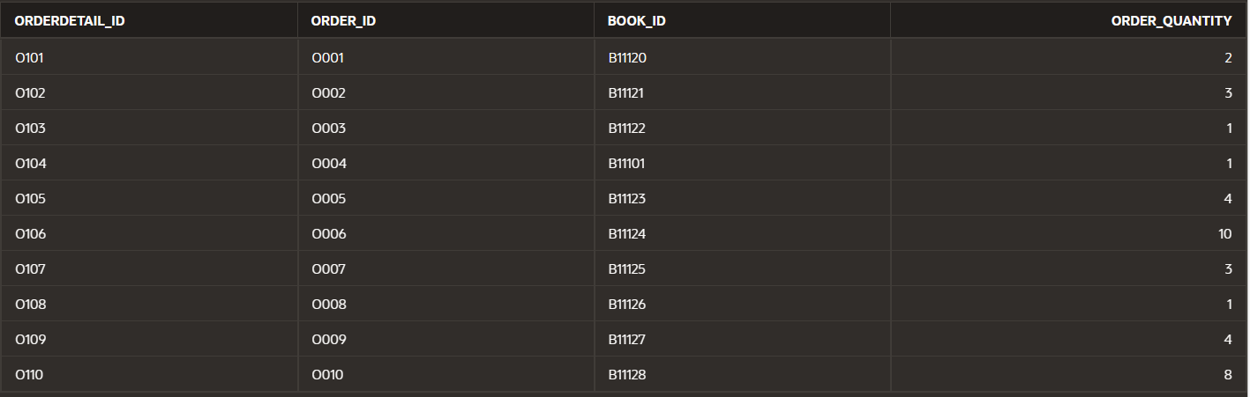
5)OrderDetail table
All atrributes have atomatic and have Primary Key. So this table in 1NF
If my table in 1NF and all my non prome attributes depend on Primary key , so this table in 2NF
To be in 3NF, this table shouldn’t be in transitivity dependence. The attributes in our table in non-transitivity dependence.And also it is in 1NF,2NF. So my table also in 3NF.
'

Slide 13
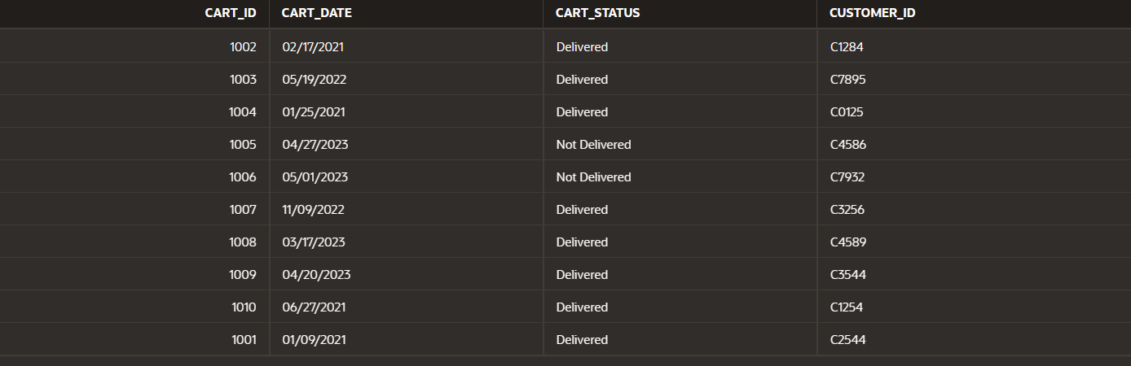
6)Cart table
All atrributes have atomatic and have Primary Key. So this table in 1NF
If my table in 1NF and all my non prome attributes depend on Primary key , so this table in 2NF
To be in 3NF, this table shouldn’t be in transitivity dependence. The attributes in our table in non-transitivity dependence.And also it is in 1NF,2NF. So my table also in 3NF.
'

Slide 14
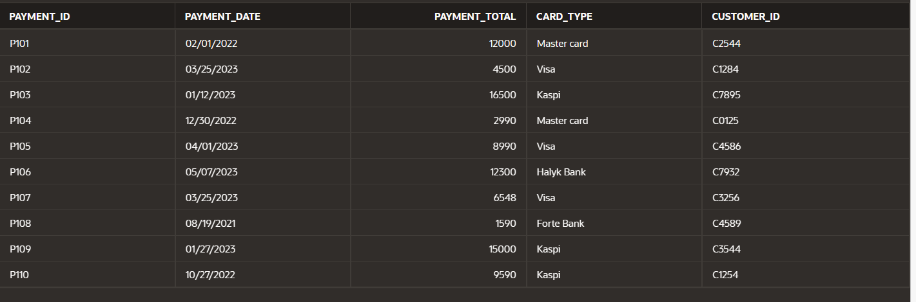
8)Payment table
All atrributes have atomatic and have Primary Key. So this table in 1NF
If my table in 1NF and all my non prome attributes depend on Primary key , so this table in 2NF
To be in 3NF, this table shouldn’t be in transitivity dependence. The attributes in our table in non-transitivity dependence.And also it is in 1NF,2NF. So my table also in 3NF.
'

Slide 15
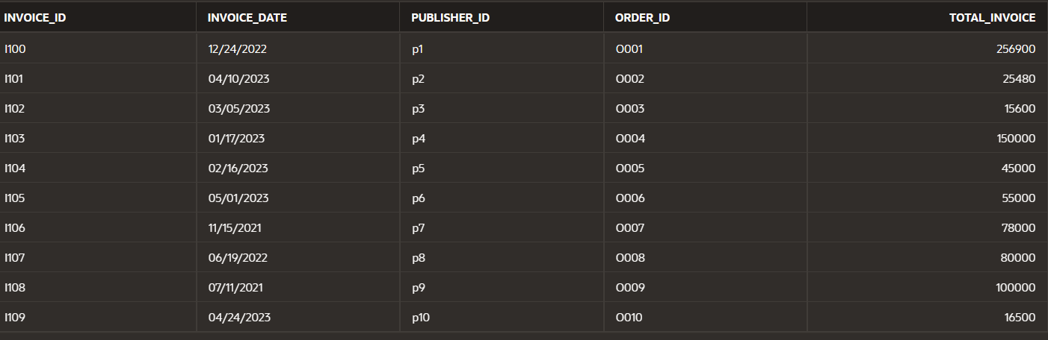
9)Invoice table
All atrributes have atomatic and have Primary Key. So this table in 1NF
If my table in 1NF and all my non prome attributes depend on Primary key , so this table in 2NF
To be in 3NF, this table shouldn’t be in transitivity dependence. The attributes in our table in non-transitivity dependence.And also it is in 1NF,2NF. So my table also in 3NF.
'

Slide 16
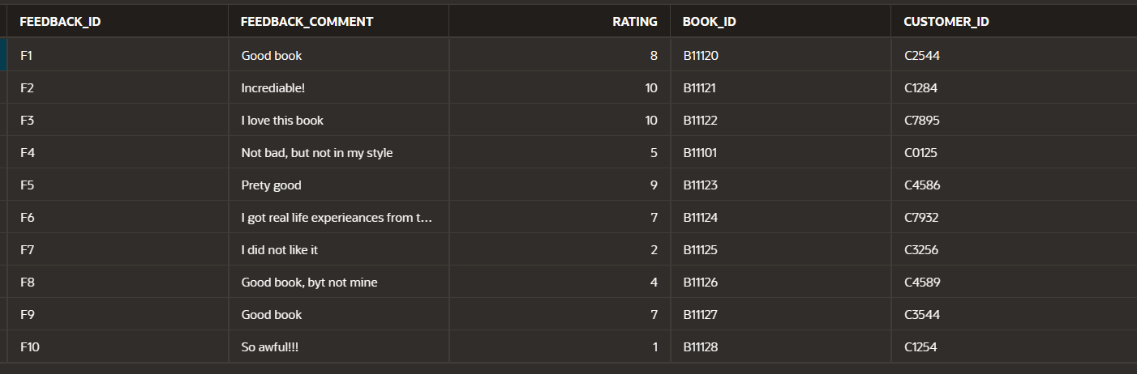
10)Feedback table
All atrributes have atomatic and have Primary Key. So this table in 1NF
If my table in 1NF and all my non prome attributes depend on Primary key , so this table in 2NF
To be in 3NF, this table shouldn’t be in transitivity dependence. The attributes in our table in non-transitivity dependence.And also it is in 1NF,2NF. So my table also in 3NF.
'

Slide 17
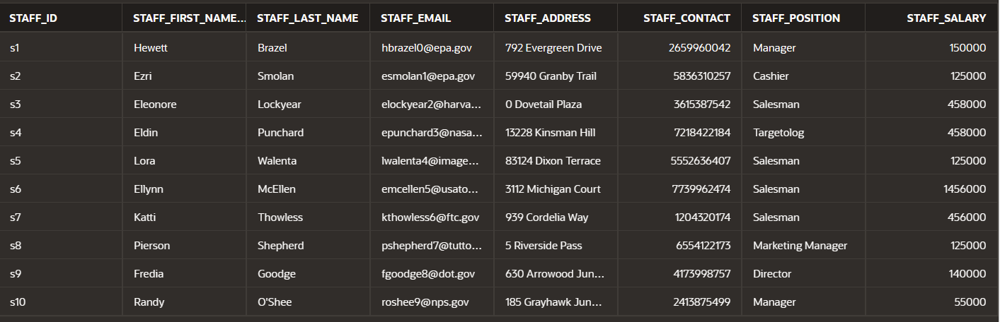
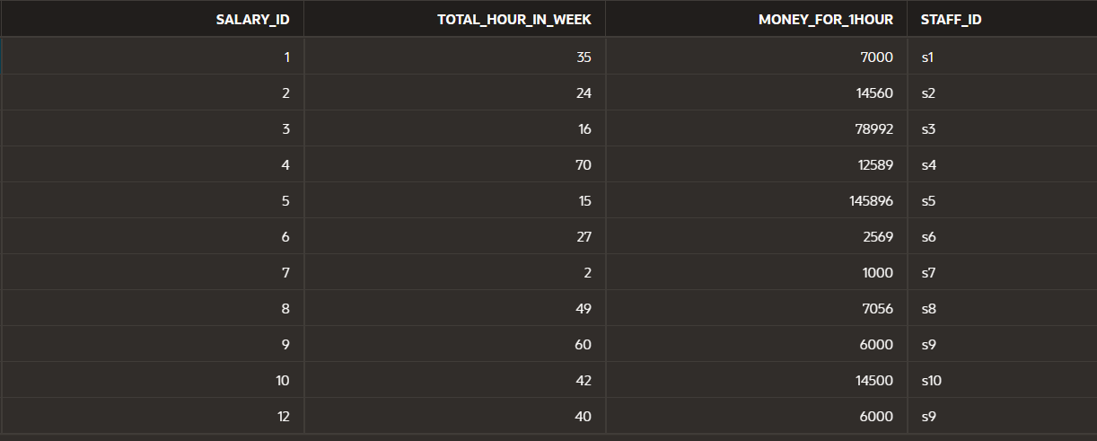
STAFF
FD: STUFF_ID -> {FIRST_NAME, L_NAME, EMAIL, POSITION, CONTACT_NUMBER, SALARY}
SALARY -> POSITION WE HAVE TRANSITIVITY: (same employee in same position get same salary)
which is not allowed in 3NF
SO WE DIVIDED OUR TABLE TO 2 TABLES:
STUFF AND SALARY:
3NF

Slide 18
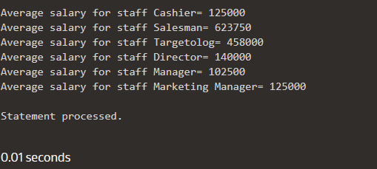
CODING PART:
Procedure which does group by information
Create or Replace PROCEDURE group_by_avg IS
v_error_code NUMBER;
v_error_message VARCHAR2(4000);
CURSOR c_emp IS
SELECT staff_position, AVG(staff_salary) as avg_salary
FROM staff
GROUP BY staff_position;
BEGIN
FOR emp_rec IN c_emp LOOP
IF emp_rec.avg_salary > 100000 THEN
DBMS_OUTPUT.PUT_LINE('Average salary for staff ' || emp_rec.staff_position || '= '|| emp_rec.avg_salary);
ELSE
DBMS_OUTPUT.PUT_LINE(emp_rec.staff_position || ': ' || emp_rec.avg_salary);
END IF;
END LOOP;
EXCEPTION
WHEN OTHERS THEN
v_error_code := SQLCODE;
v_error_message := SQLERRM;
DBMS_OUTPUT.PUT_LINE('Error ' || v_error_code || ': ' || v_error_message);
END;
This procedure retrieves the average salary for each staff position from the "staff" table, checks if it is greater than a certain value, and displays the result for each staff position by using Group By and the DBMS_OUTPUT.PUT_LINE function to get result.
Check:
BEGIN
-- Call the procedure
GROUP_BY_AVG;
END;

Slide 19
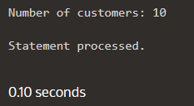
2) Function which counts the number of records
Create or Replace FUNCTION count_customers RETURN NUMBER IS
record_count NUMBER;
BEGIN
SELECT COUNT(*) INTO record_count FROM customer;
RETURN record_count;
END;
DECLARE
num_customers NUMBER;
BEGIN
num_customers := count_customers;
DBMS_OUTPUT.PUT_LINE('Number of customers: ' || num_customers);
END;
This function returns the number of rows in the "customer" table in the database.

Slide 20
3) Procedure which uses SQL%ROWCOUNT to determine the number of rows affected
Create or Replace PROCEDURE update_card(p_card_t NUMBER,
p_new_card VARCHAR
)
IS
BEGIN
UPDATE PAYMENT SET CARD_TYPE = p_new_card WHERE PAYMENT_TOTAL = p_card_t;
IF SQL%ROWCOUNT = 1 THEN
DBMS_OUTPUT.PUT_LINE('Card type updated successfully.');
ELSE
DBMS_OUTPUT.PUT_LINE('Card not found.');
END IF;
END;

Slide 21
4) Add user-defined exception which disallows to enter title of item (e.g. book) to be less than 5 characters
DECLARE
book_name VARCHAR2(50) := 'Edu';
book_name_min_length CONSTANT NUMBER := 5;
invalid_book_name EXCEPTION;
PRAGMA EXCEPTION_INIT(invalid_book_name, -20001);
BEGIN
IF LENGTH(book_name) < book_name_min_length THEN
RAISE invalid_book_name;
ELSE
DBMS_OUTPUT.PUT_LINE('This word is valid');
END IF;
EXCEPTION
WHEN invalid_book_name THEN
DBMS_OUTPUT.PUT_LINE('Word - must be at least ' || book_name_min_length || ' characters long');
END;
This code demonstrates how to define and use a user-defined exception . The code declares a variable named "book_name" , which holds a book name, and "book_name_min_length" of type CONSTANT NUMBER, which holds the minimum length required for the book name. The code defines a user-defined exception named "invalid_book_name" using the EXCEPTION keyword and the PRAGMA EXCEPTION_INIT statement. Inside the BEGIN block, the code checks whether the length of the "book_name"

Slide 22
5)
Create or Replace TRIGGER SalaryAvg
AFTER INSERT ON salary
FOR EACH ROW
DECLARE
PRAGMA AUTONOMOUS_TRANSACTION;
BEGIN
IF :new.MONEY_FOR_1HOUR = 3000 THEN
UPDATE Salary SET MONEY_FOR_1HOUR = (SELECT min(TOTAL_HOUR_IN_WEEK)*3000 FROM salary)
WHERE staff_id = (SELECT staff_id FROM staff WHERE staff_position LIKE 'Director');
COMMIT;
END IF;
END;
UPDATE salary
SET money_for_1hour = (SELECT min(total_hour_in_week)*3000 FROM salary)
WHERE staff_id = (SELECT staff_id FROM staff WHERE staff_position LIKE 'Director');
INSERT INTO salary (salary_id, total_hour_in_week, money_for_1hour, staff_id)
VALUES (11, 40, 3000, 's5');

Slide 23
create or replace TRIGGER before_insert_book
BEFORE INSERT ON Book
FOR EACH ROW
DECLARE
curr_table NUMBER;
check_name EXCEPTION;
BEGIN
SELECT COUNT(*) INTO curr_table FROM book;
DBMS_OUTPUT.PUT_LINE('Current number of rows in table is ' || curr_table);
IF LENGTH(:NEW.book_name) < 6 THEN
RAISE_APPLICATION_ERROR(-20001, 'Length of name should be more or equal than 6');
END IF;
EXCEPTION
WHEN check_name THEN
DBMS_OUTPUT.PUT_LINE('Name must be at least 6 characters long');
END;
/
insert into book (book_id,book_name,book_type,book_serial_number,book_quantity,book_price, BOOK_PUBLICATION_DATE)
values('B10256','Little prince','Life',1040, 14,3800, 'Jan 14 1997');

Slide 24

That’s it! Thank you very much for your time!
If you have any questions regarding the presentation, please feel free to ask us!
We will be more than happy to answer you ☺

